Slide 1
Chapter 10:
Multirate Digital Signal Processing

Slide 2
References
[1] Proakis and Manolakis, Digital Signal Processing, 3rd Ed. (1996), 4th Ed. (2006), Prentice-Hall.
[2] Steven M. Kay, Fundamentals of Statistical Signal Processing: Estimation Theory, Prentice Hall, 1993.
[3] Dimitris G. Manolakis, Vinay K. Ingle, Stephen M. Kogon, Statistical and Adaptive Signal Processing, Artech House, 2005.

Slide 3
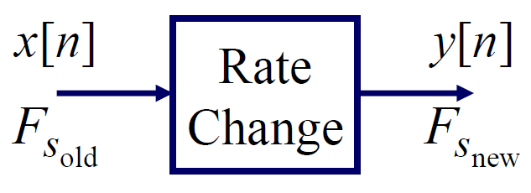
Introduction (1)
Multirate DSP
Main question: How to change the sampling rate of a discrete-time signal without reconstructing and then re-sampling.
Motivation:
1. Interconnect subsystems having different F_{s}
2. Improve certain DSP operations (e.g., very narrow filters)
3. Efficient implementation of certain DSP tasks (e.g. correlation)
Two basic operations
1. Decimation – Decrease F_{s} by an integer factor: F_{snew}= (F_{sold})/M
2. Expansion – Increase F_{s} by an integer factor: F_{snew}= (F_{sold})×L
Can combine to get a change by a rational factor:
F_{snew}= (F_{sold})×L/M

Slide 4
Introduction (2)
Approach to study decimation & expansion
1. Specify operations in time domain – Easy, but not enlightening
2. Determine impact in frequency domain –Harder, but more enlightening
3. Explore implementation and applications (e.g., Polyphase, Filterbanks)

Slide 5
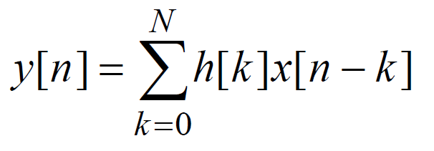
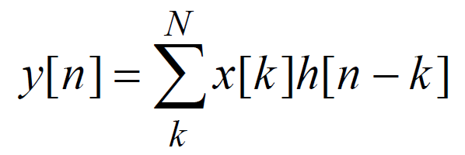
Introduction (3)
FIR filter review
Much of the material in Multirate DSP uses FIR filtering and therefore it is important to review some ways of viewing FIR filters.
Let the FIR filter be h[0], h[1], …, h[N] and the input be x[n], then the output of the filter is given by convolution in either of two equivalent forms:
Input slides past filter
Filter slides past input

Slide 6
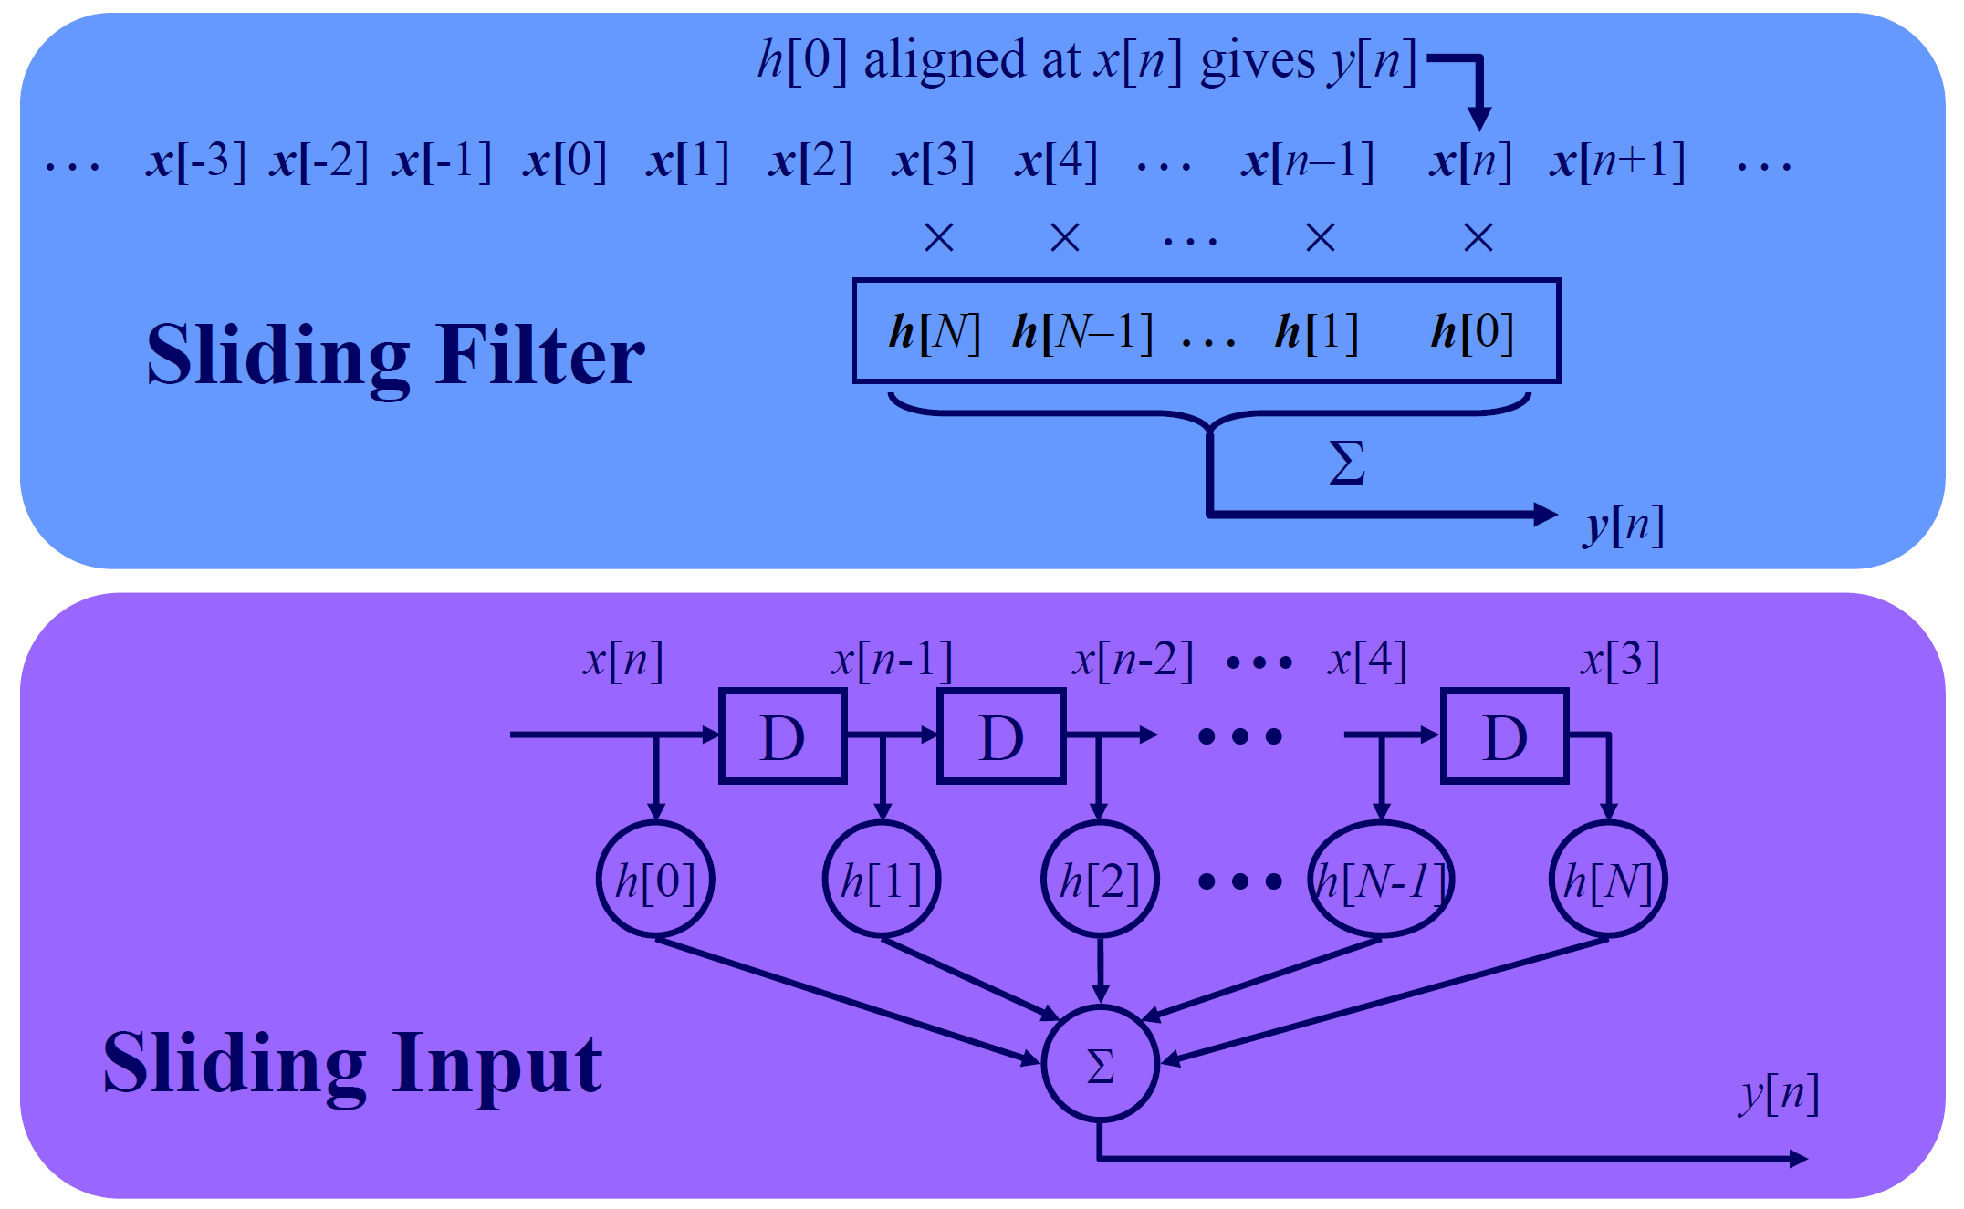
Introduction (4)

Slide 7
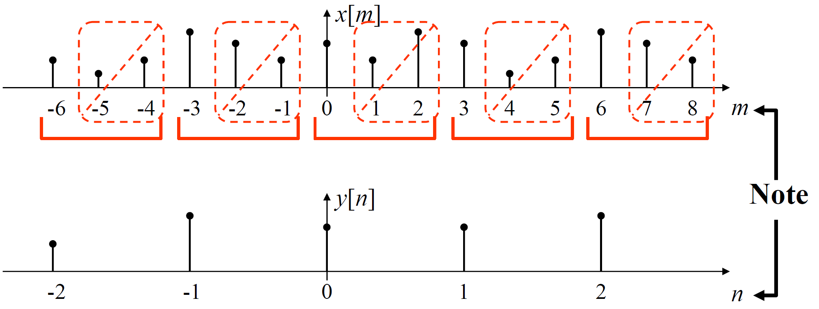
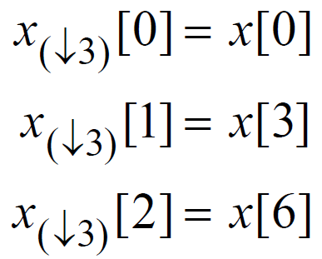
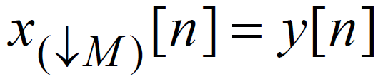
Decimation and Expansion (1)
Decimation –Time-domain graphic view
M-Fold decimation: Out of every block of M input samples, keep only 1 sample.
m is original sample index, n is new sample index.
m = Mn for n∈Z
Notation:
M = 3

Slide 8
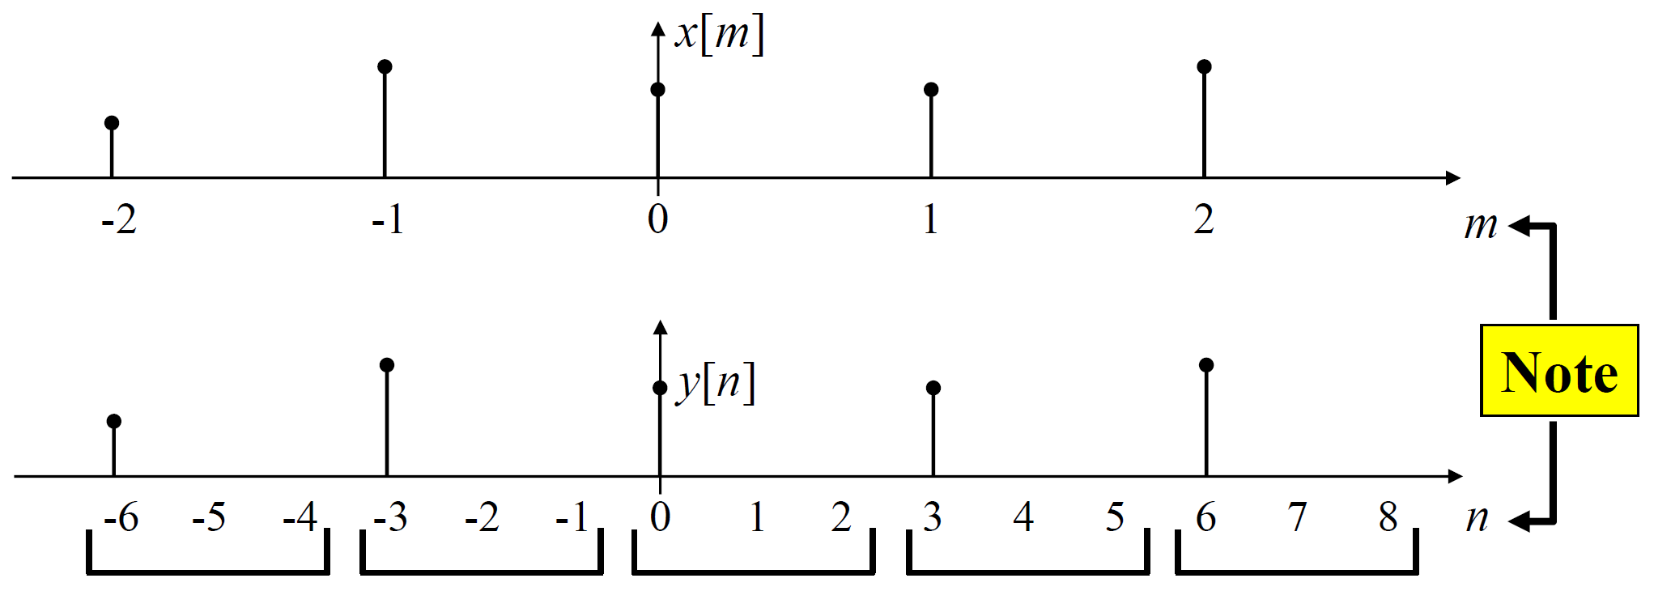
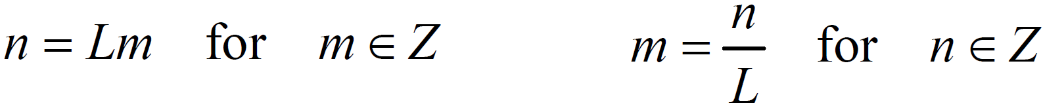
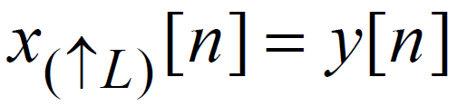
Decimation and Expansion (2)
Expansion –Time-domain graphic view
L-Fold decimation: To each input sample, “tack on” L-1 zeros.
Notation:

Slide 9
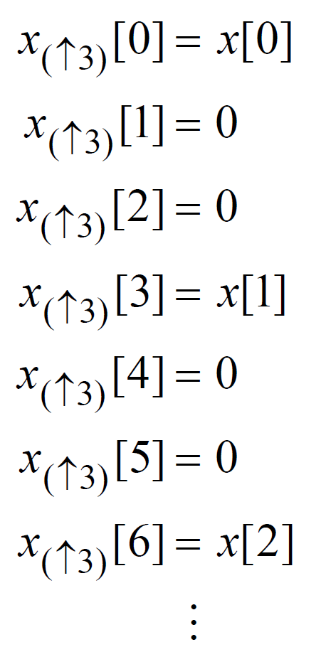
Decimation and Expansion (3)
Example: L = 3

Slide 10
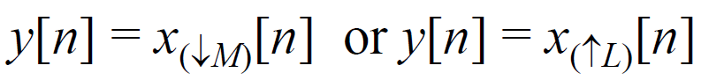
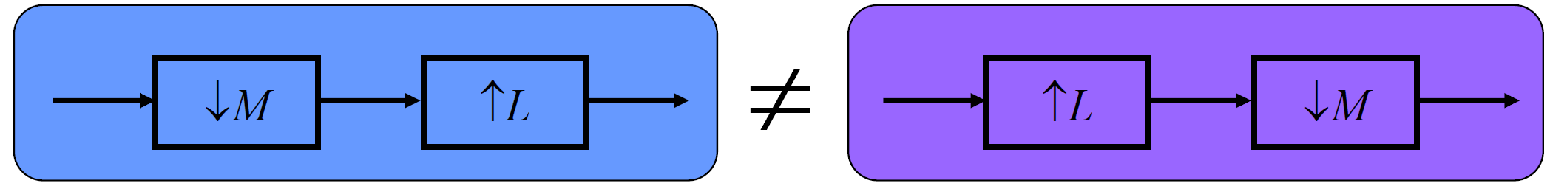
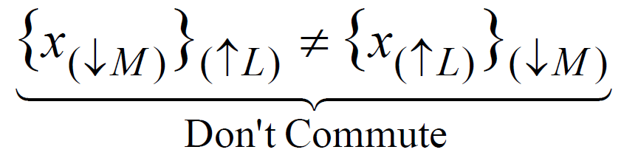
Decimation and Expansion (4)
Properties of rate change processing
1. Linear:
Similar for ↑L .
2. Time-varying system (not time-invariant)
If x[n] → y[n], where either
Then in general:
3. Expansion and decimation do not commute (In general)

Slide 11
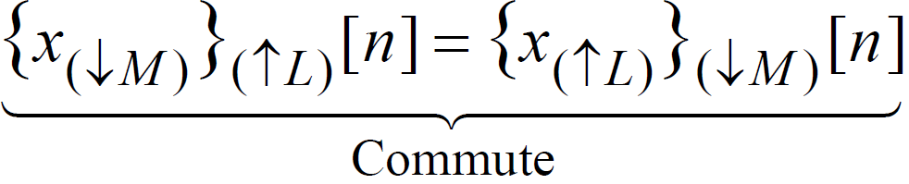
Decimation and Expansion (5)
Special case:
Theorem: If M and L are co-prime (also called “relatively prime”), then
Two integers are co-prime if they have no common factors.
M= 9 (1, 3, 9) and L= 16 (1, 2, 4, 8).

Slide 12
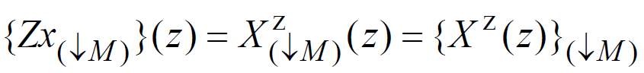
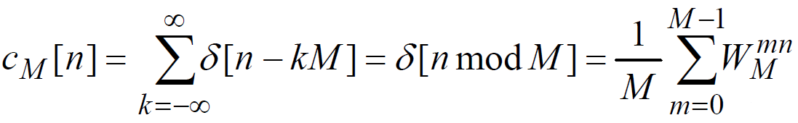
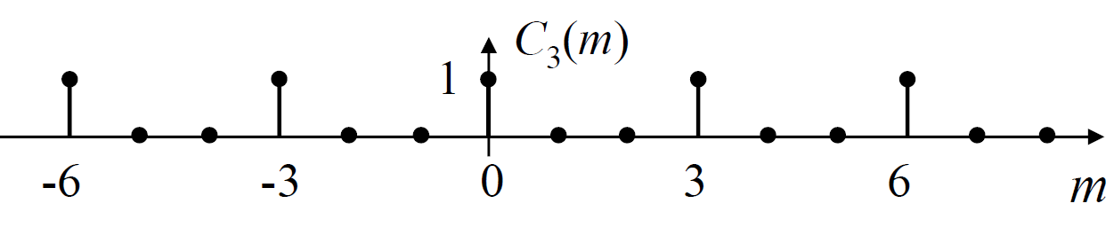
Decimation and Expansion (6)
M-Fold decimation –frequency-domain
Notation:
Similar for DTFT•
Similar for Expansion
Find X_{(↓M)}(z) in terms of X(z)? To answer this we need to define a useful function (“comb” function):
where W_{M} = e ^{j2π/M}

Slide 13
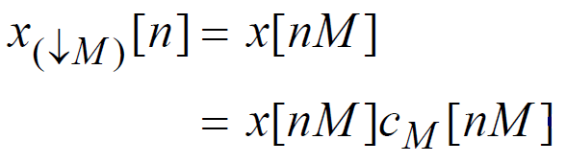
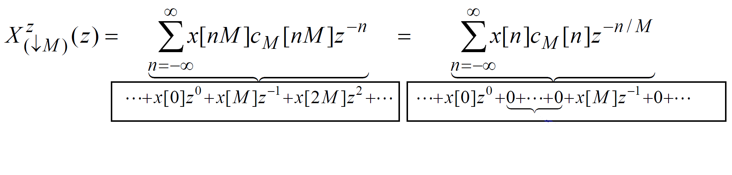
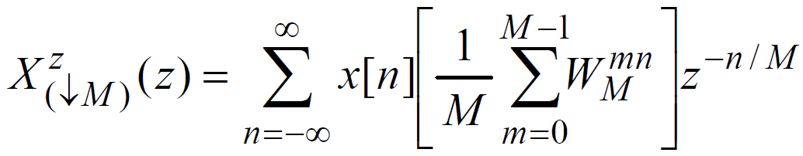
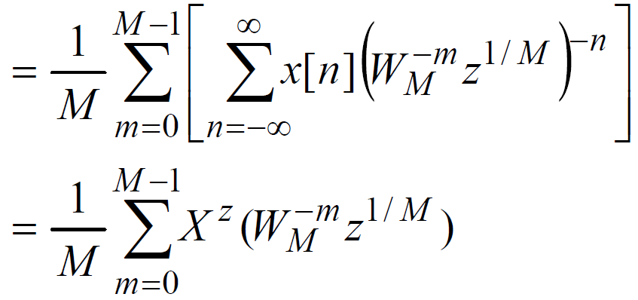
Decimation and Expansion (7)
Now, use the comb function to write decimation:
Take Z-Transform, using this form:

Slide 14
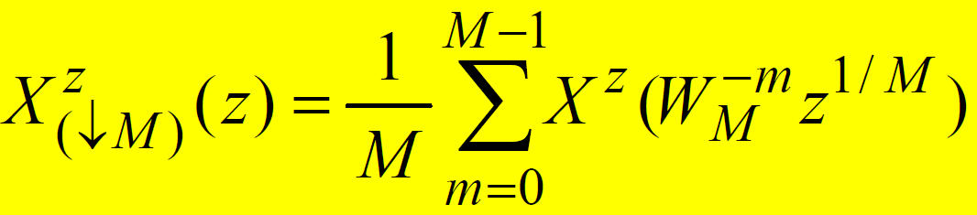
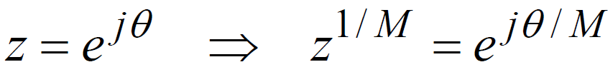
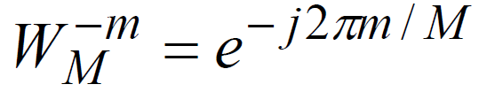
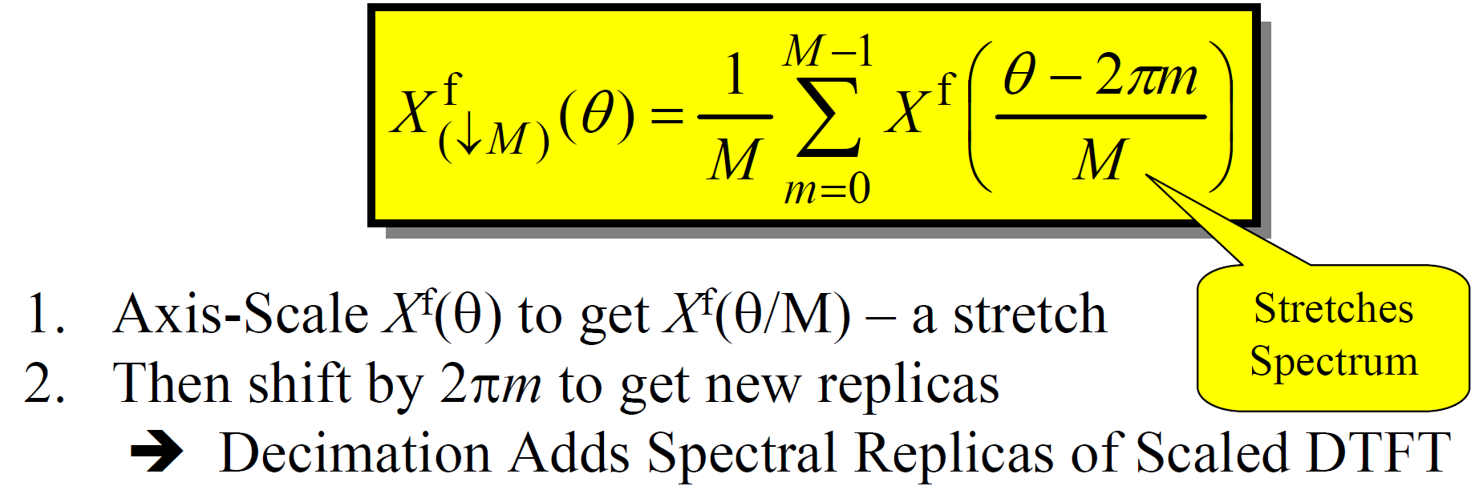
Decimation and Expansion (8)
Therefore, Z-transform (ZT) decimated signal:
DTFT is the ZT evaluated on the unit circle:
Also, by definition:
Then, DTFT of decimated signal is:

Slide 15
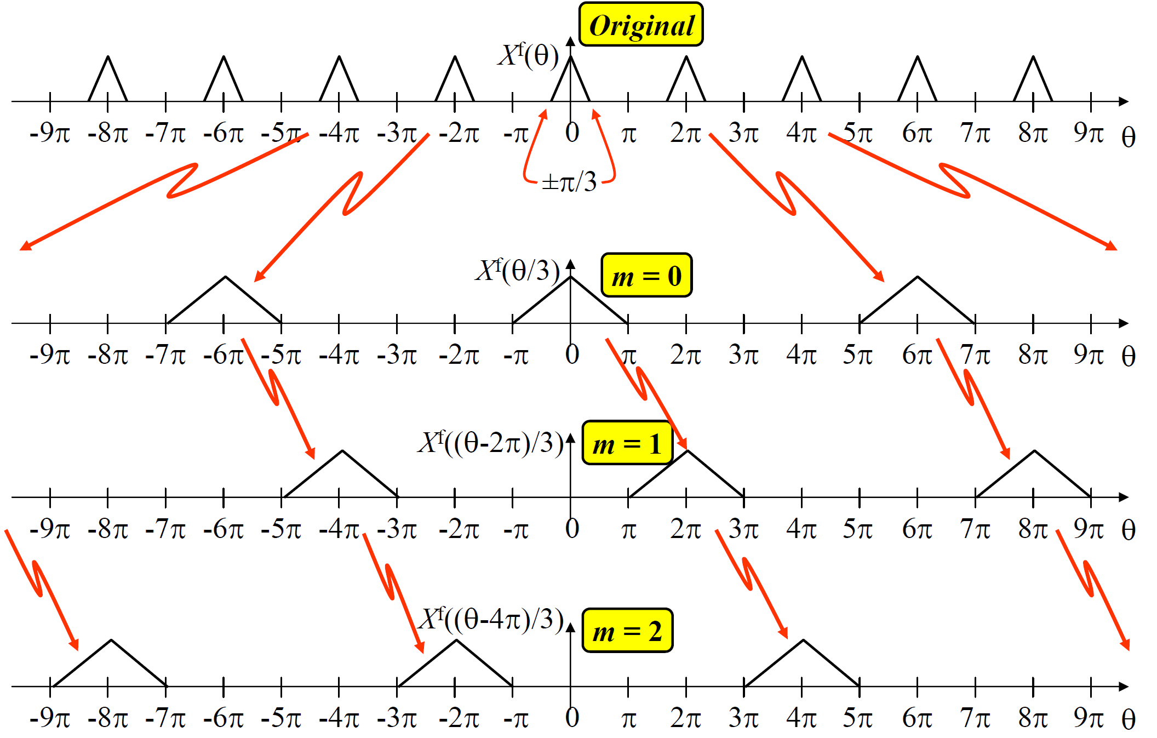
Decimation and Expansion (9)
Example: DTFT for M-Fold decimation, M = 3

Slide 16
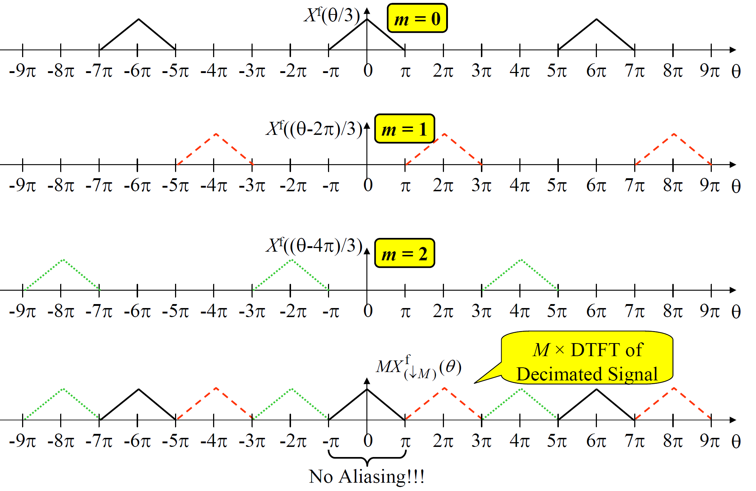
Decimation and Expansion (10)

Slide 17
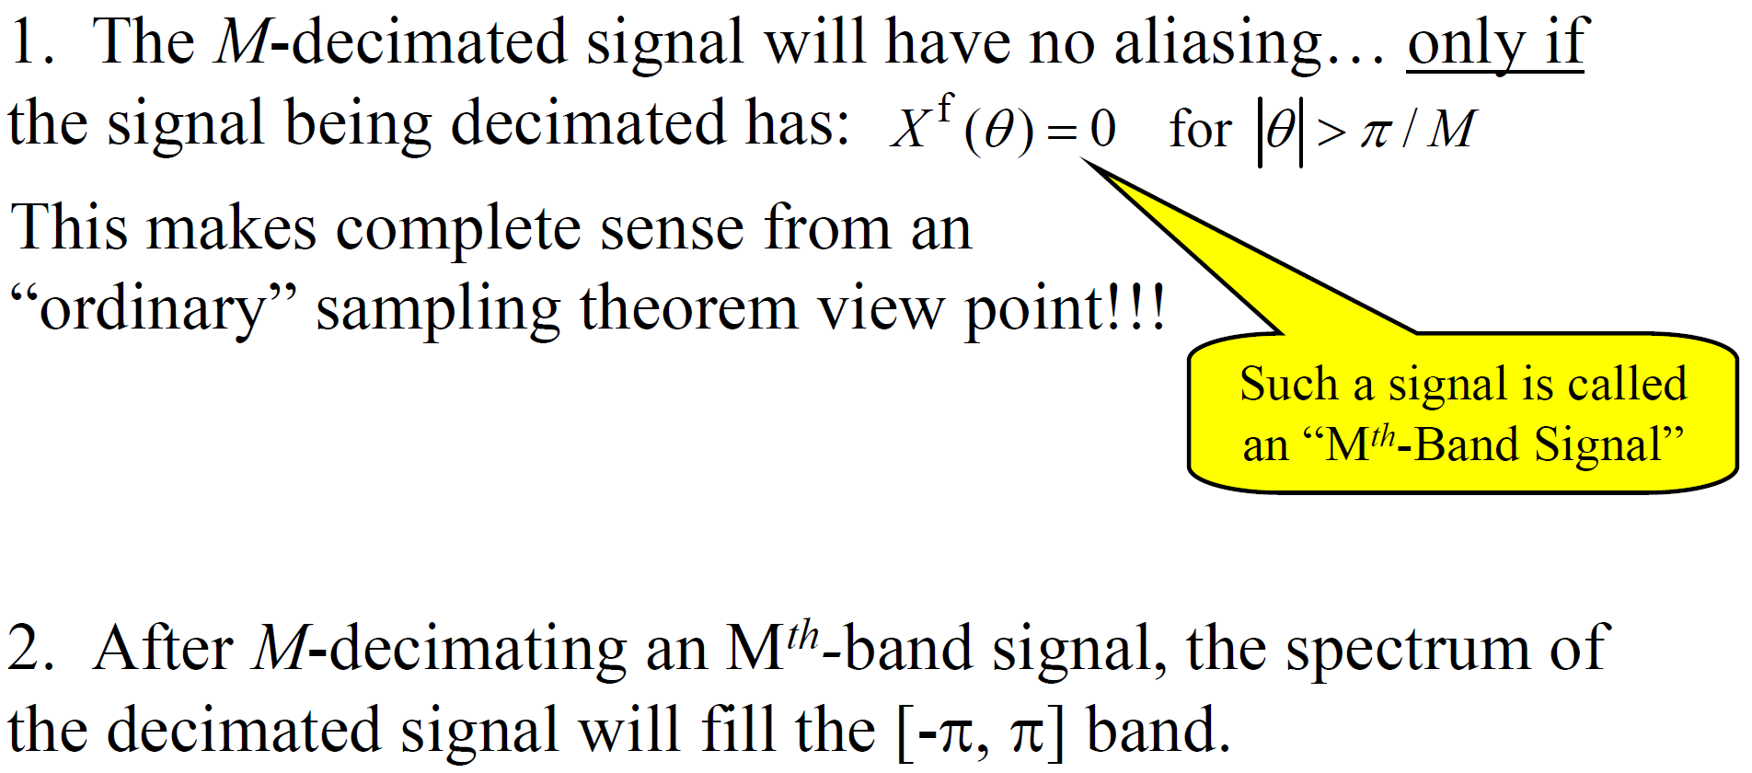
Decimation and Expansion (11)

Slide 18
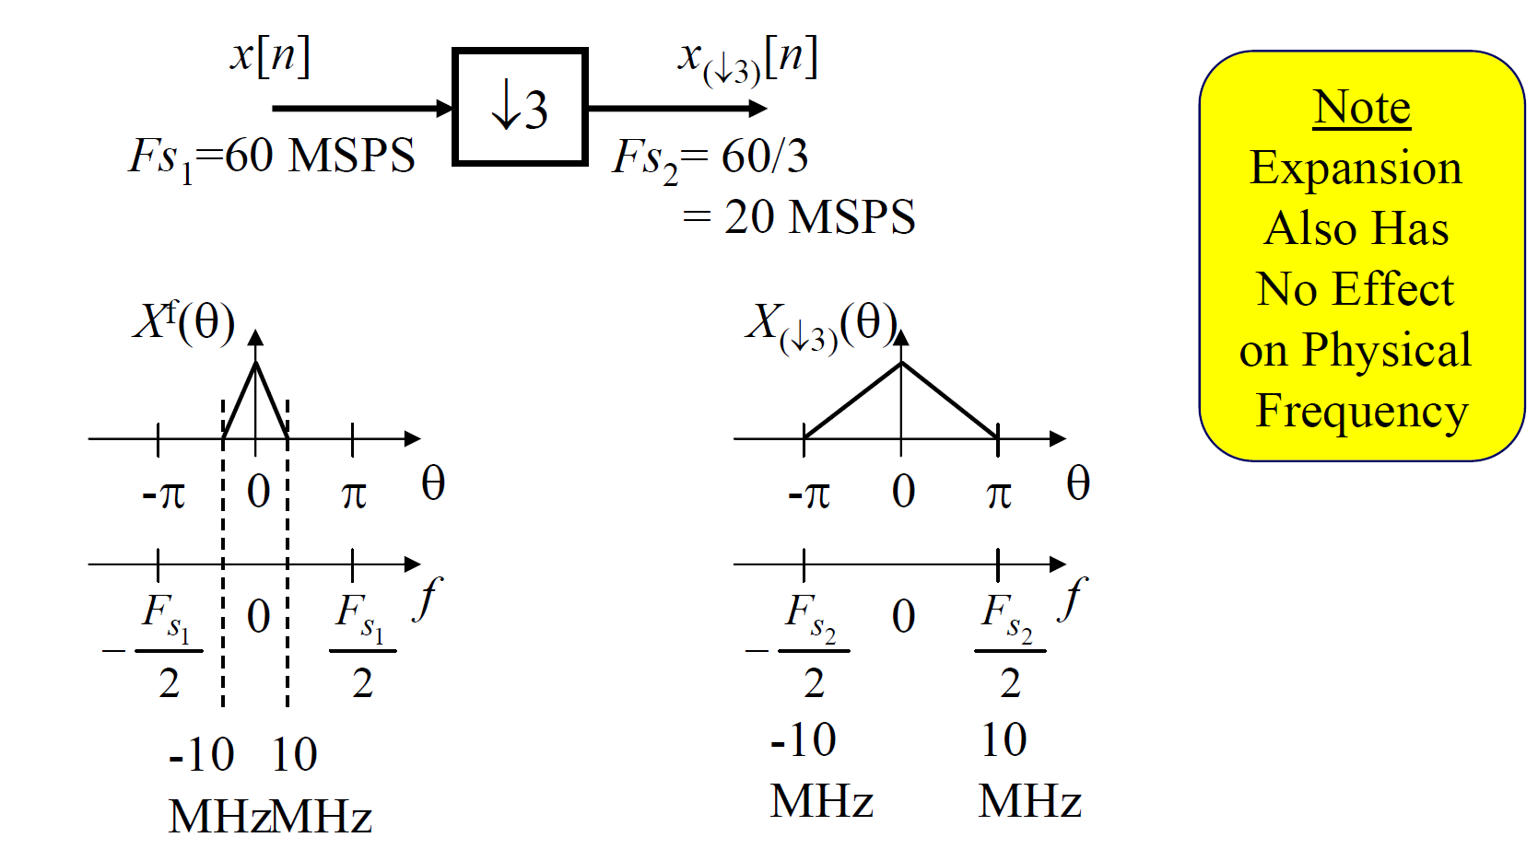
Decimation and Expansion (12)
Effect on physical frequency:
Although decimation changes the digital frequency of the signal, the corresponding physical frequency is not changed, as the following example shows:

Slide 19
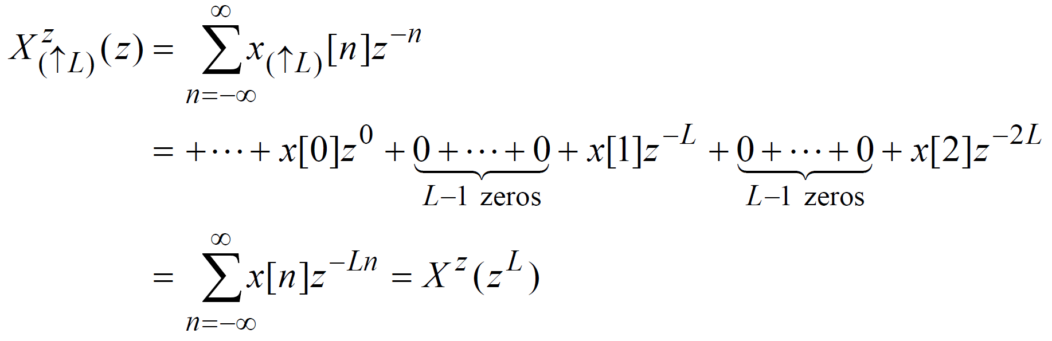
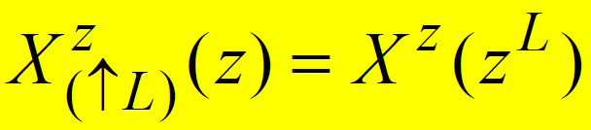
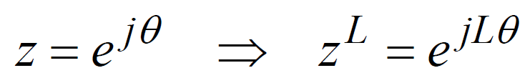
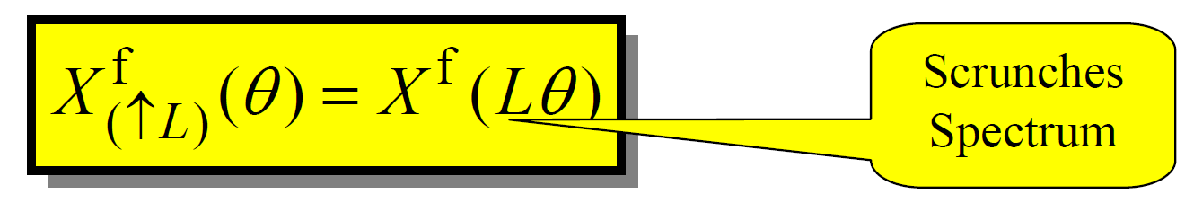
Decimation and Expansion (13)
L-Fold expansion –frequency-domain:
Find X_{(↑L)}(z) in terms of X(z)?
ZT of expanded signal is:
DTFT is the ZT evaluated on the unit circle:
DTFT of expanded signal is:

Slide 20
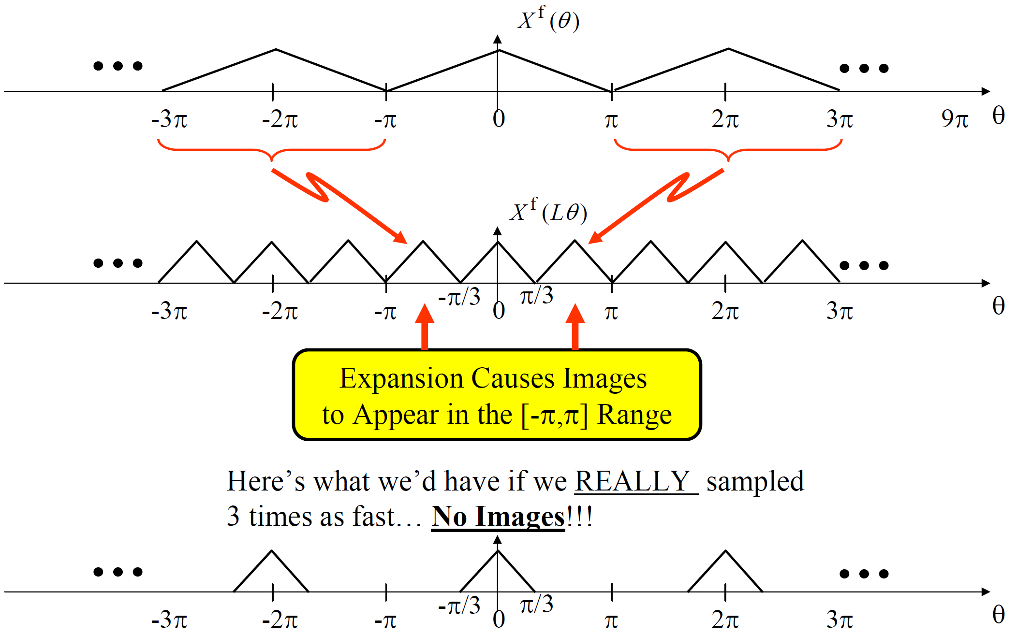
Decimation and Expansion (14)
Example: DTFT for L-fold expansion, L = 3

Slide 21
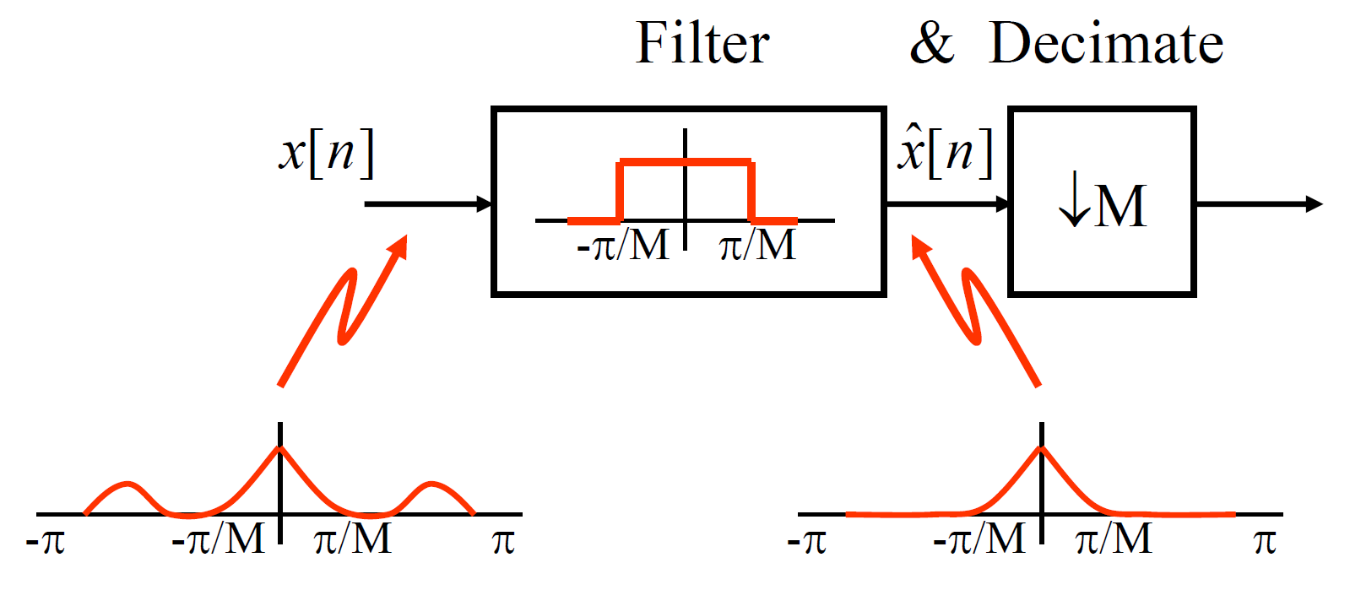
Linear Filtering for Decimation and Expansion (1)
Need for filtering –decimation
Recall: M-Fold Decimation has no aliasing if original signal is an “Mth band signal”
⇒ Usually need to ensure this before decimating
⇒ Pre-filter with M-Band D-T LPF (i.e. a D-T anti-alias filter)

Slide 22
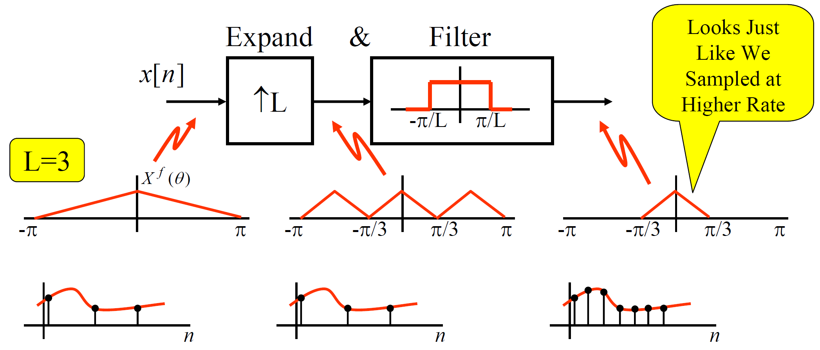
Linear Filtering for Decimation and Expansion (2)
Need for filtering –expansion
Recall: Expansion leaves high frequency images that shouldn’t be there.
⇒ Need to remove these after expanding
⇒ Post-filter with L-Band D-T LPF (an “anti-image”filter)

Slide 23
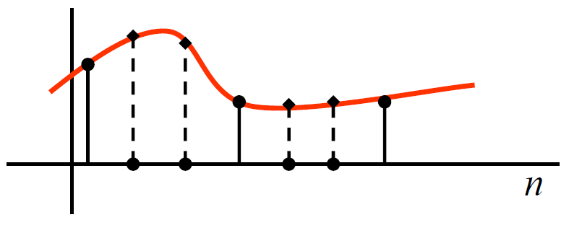
Linear Filtering for Decimation and Expansion (3)
So, the ideal post-filter converts the inserted zeros into interpolated samples:
⇒ Expansion-filtering is called “Interpolation”

Slide 24
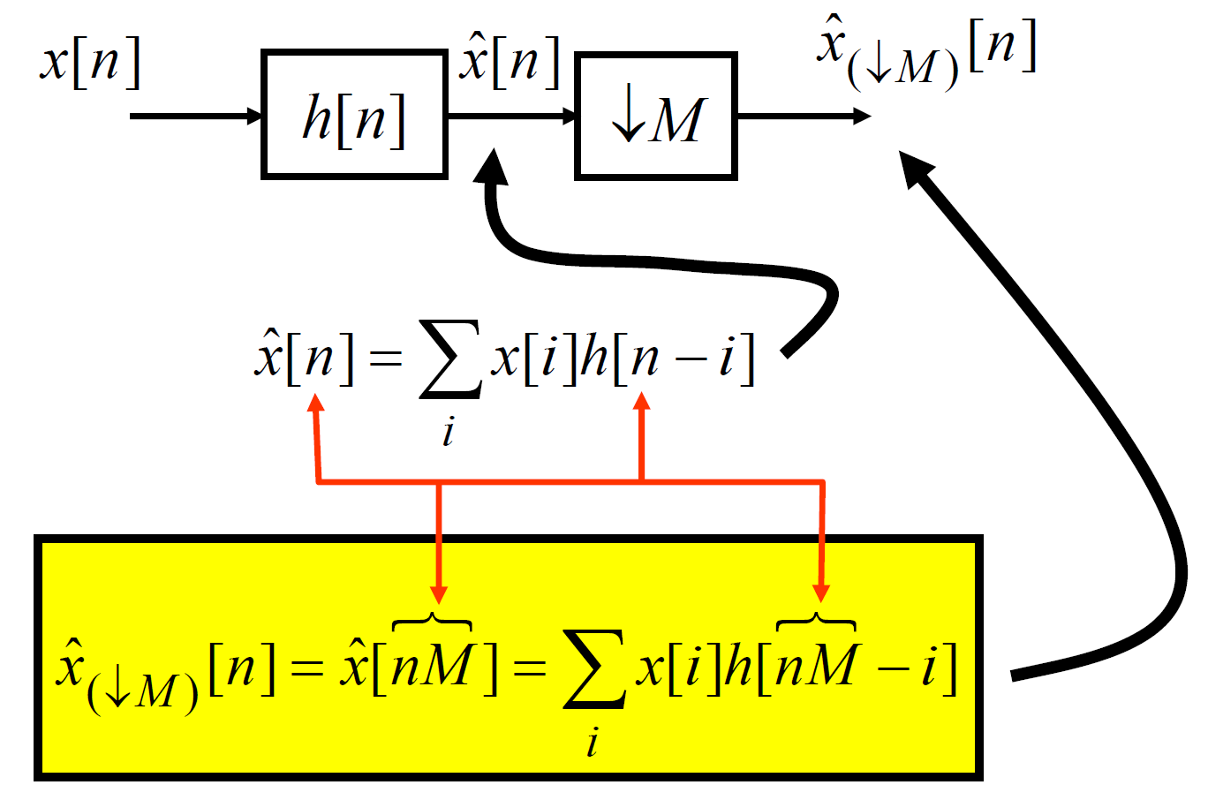
Linear Filtering for Decimation and Expansion (4)
Time-domain description –Filter/Decimate
To get a time-domain description of filter/decimate:

Slide 25
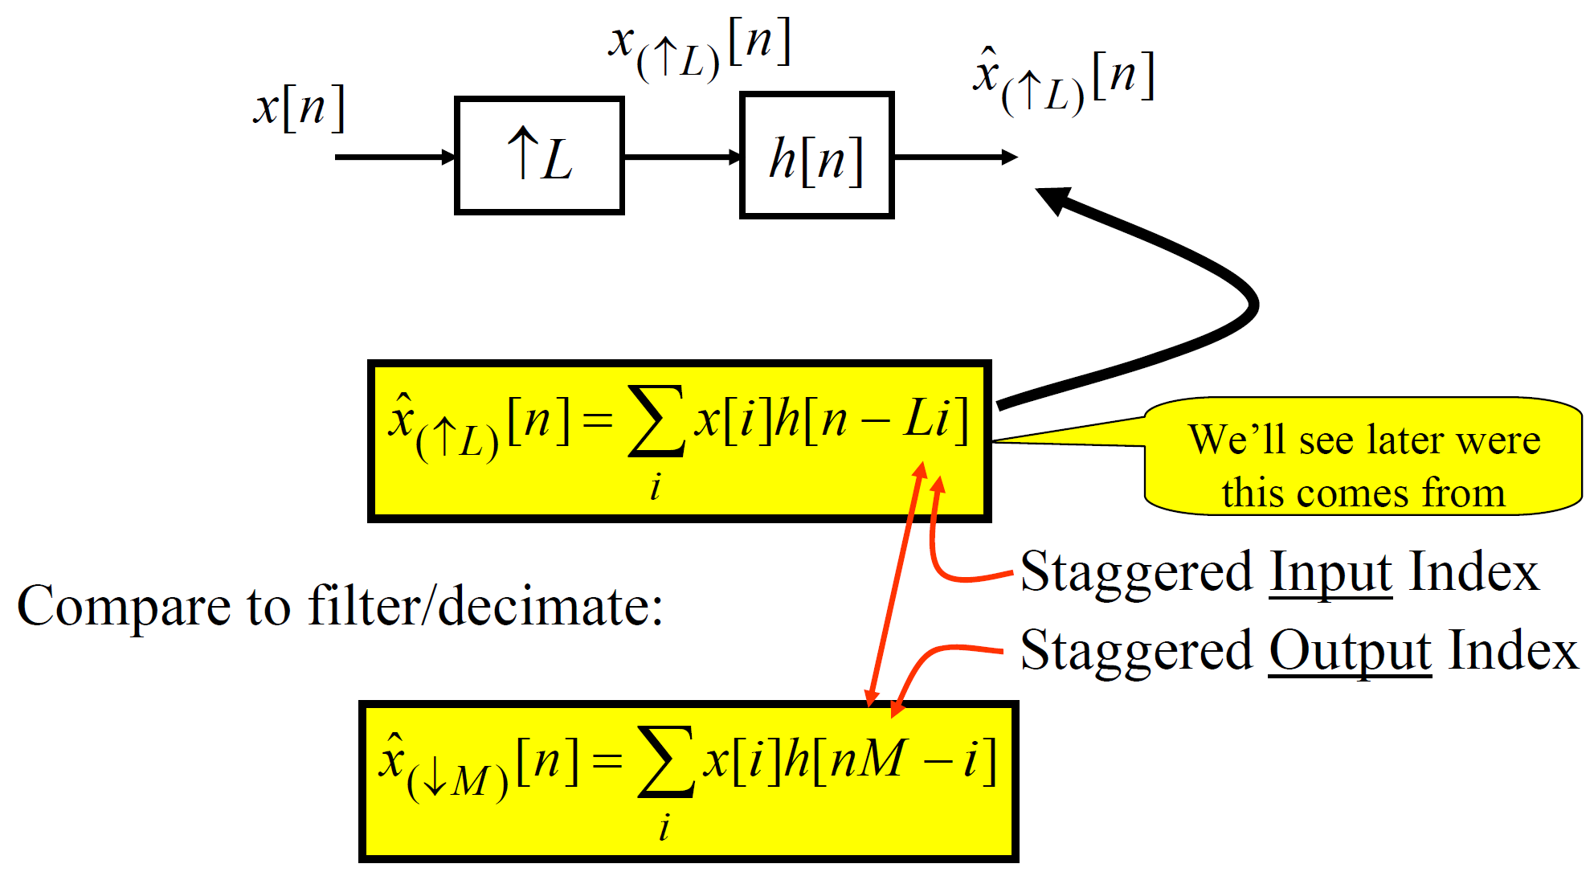
Linear Filtering for Decimation and Expansion (5)
Time-domain description –Expand/Filter
To get a time-domain description of expand/filter:

Slide 26
Polyphase Filters (1)
Polyphase is a way of doing sampling-rate conversion that leads to very efficient implementations. Moreover, it leads to very general viewpoints that are useful in building filter banks.

Slide 27
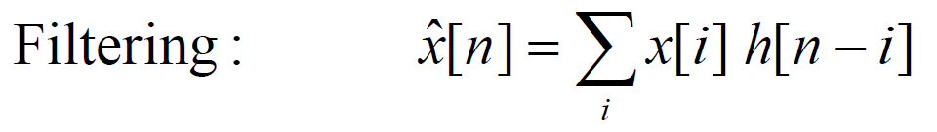
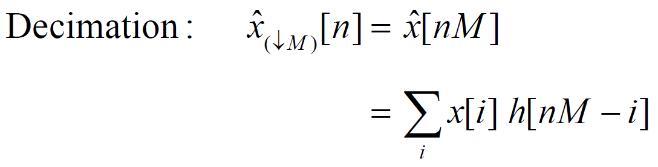
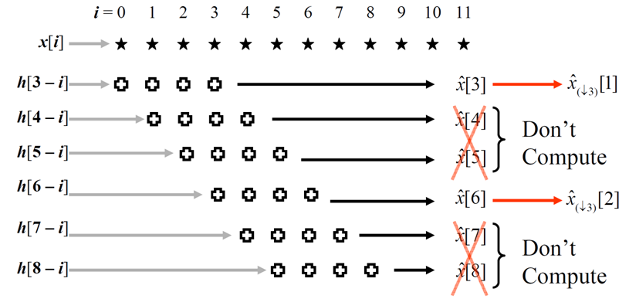
Polyphase Filters (2)
Efficient FIR filtering for decimation
M = 3

Slide 28
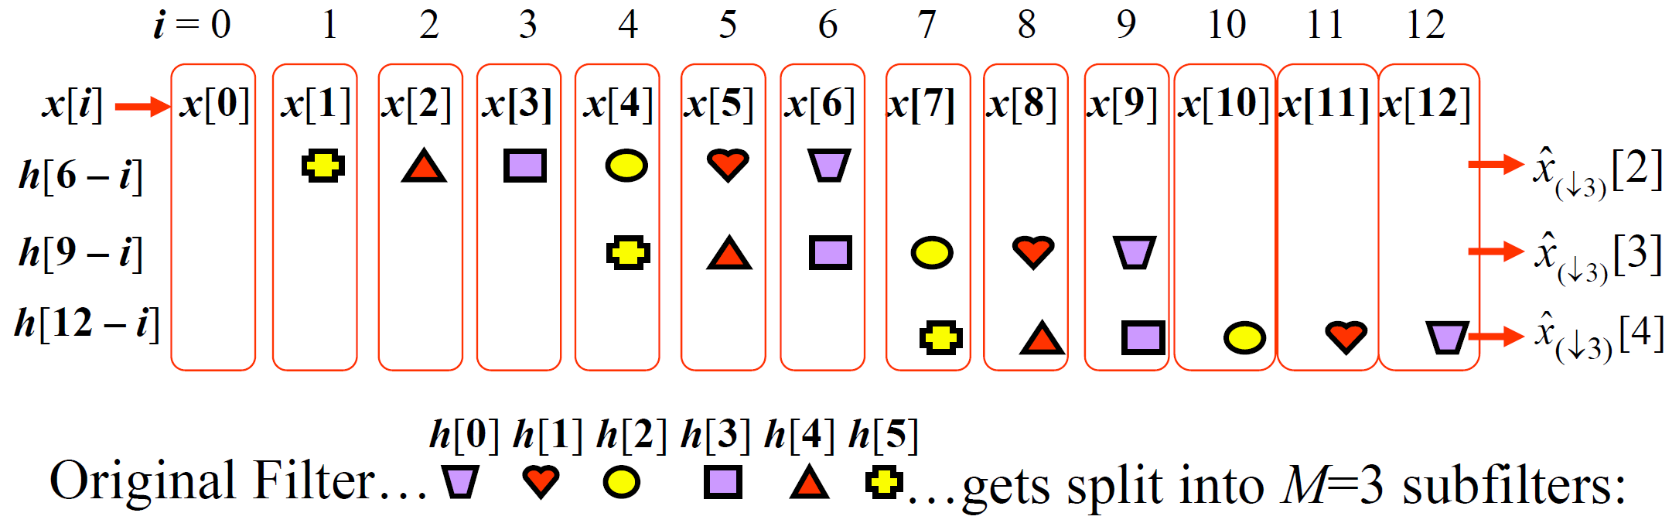
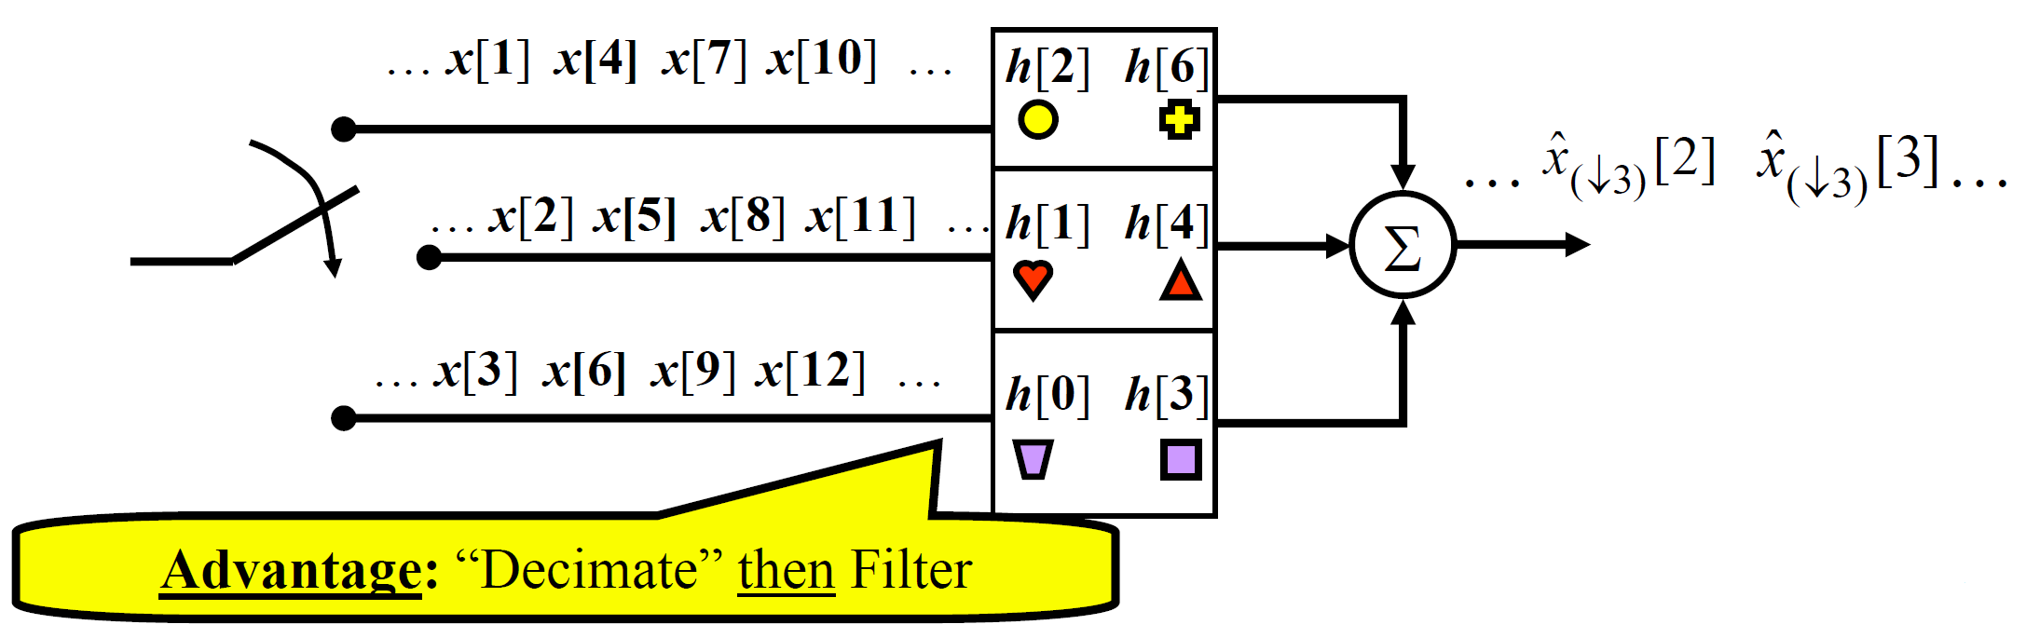
Polyphase Filters (3)
Polyphase form of FIR decimation advantage:

Slide 29
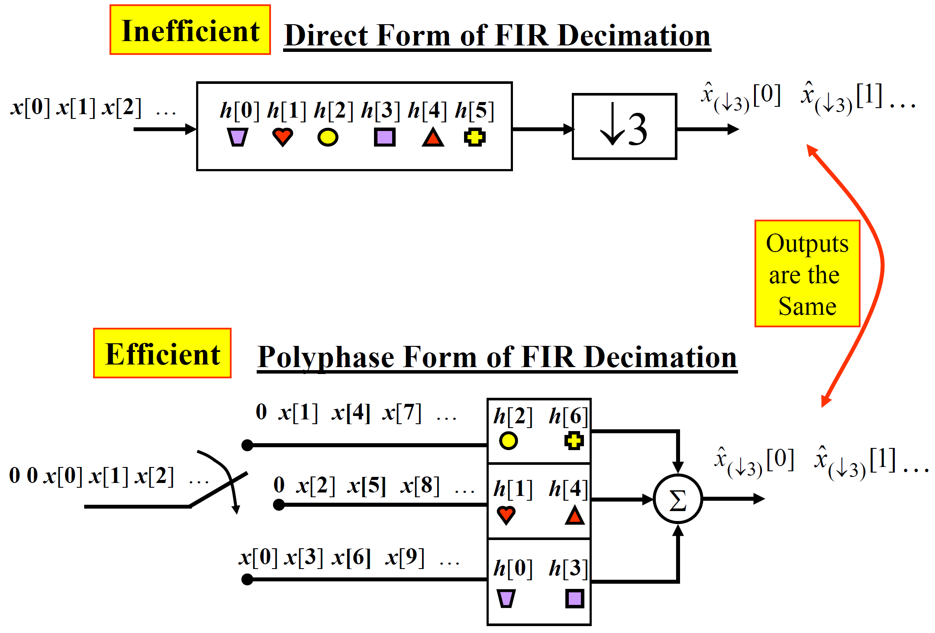
Polyphase Filters (4)

Slide 30
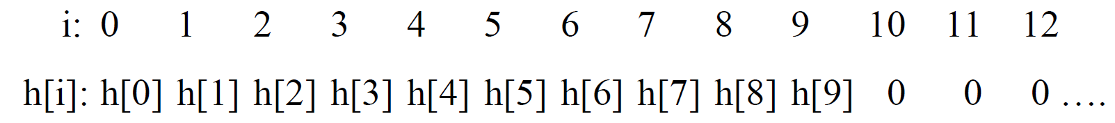
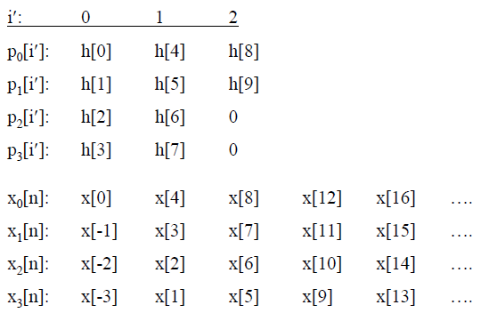
Polyphase Filters (5)
Example: Polyphase filters for decimation
Consider length-10 filter with M = 4
Length of polyphase filters: ceil{length/M} = ceil{10/4} = 3

Slide 31
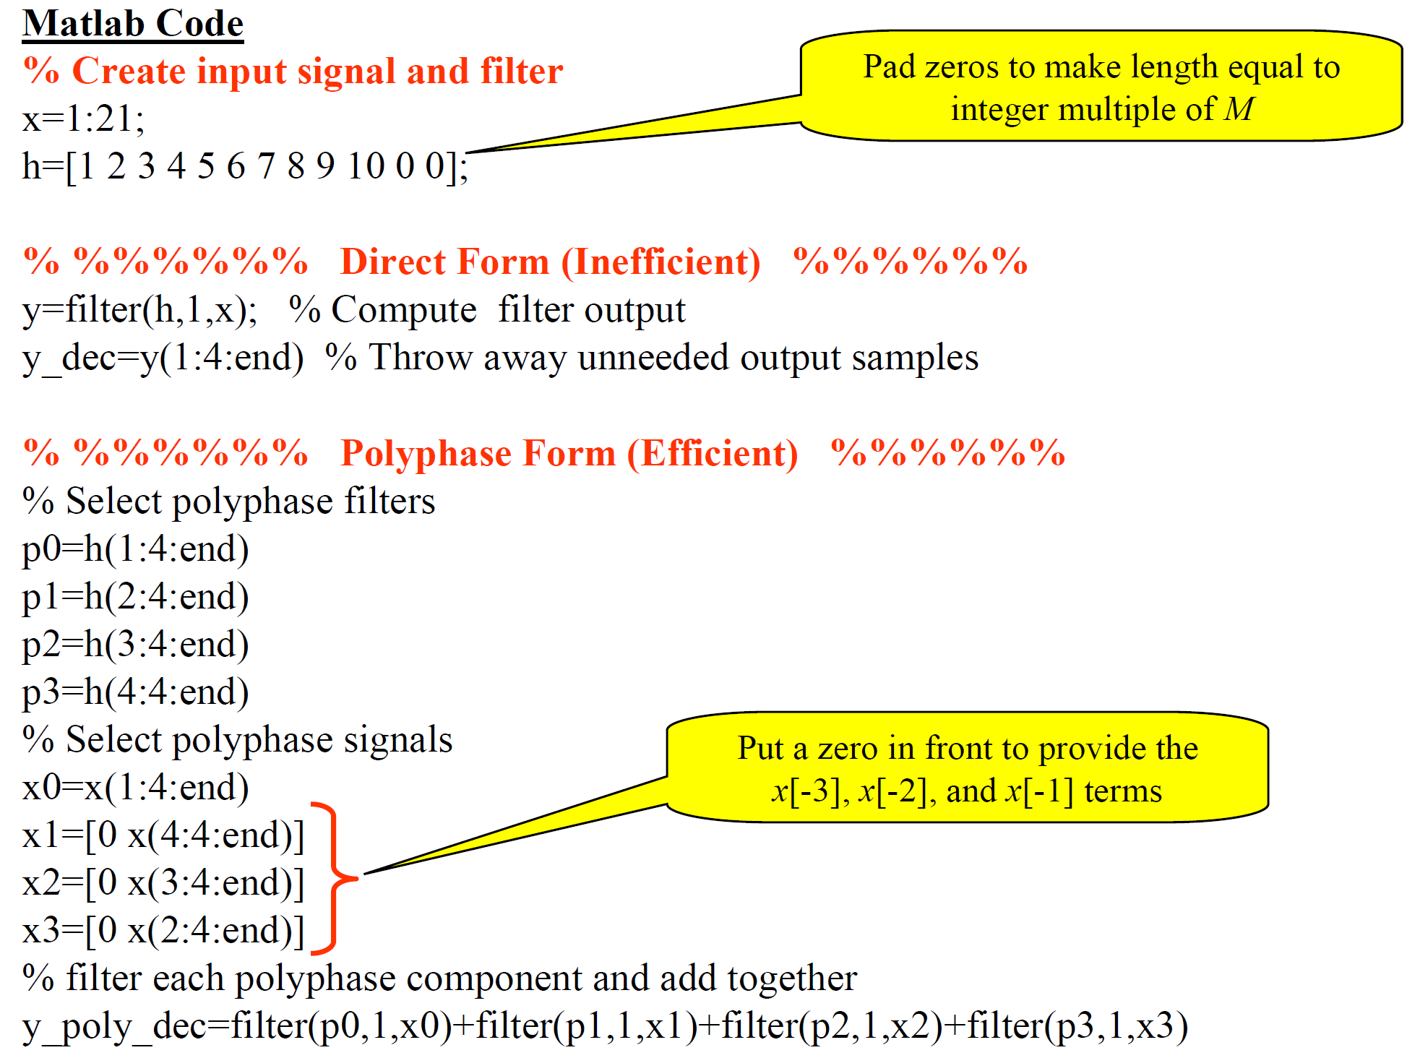
Polyphase Filters (6)

Slide 32
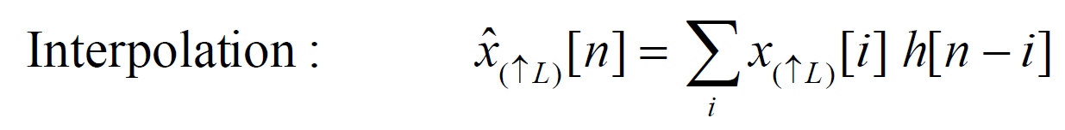

Polyphase Filters (7)
Efficient FIR filtering for interpolation
L = 3

Slide 33

Polyphase Filters (8)
L = 3

Slide 34

Polyphase Filters (9)
L = 3

Slide 35

Polyphase Filters (10)
Multirate identities – The noble identities
These provide analysis “tricks” useful when dealing with mathematical analysis of multirate systems.
The question in general is: How can we interchange the order of filtering with decimation/expansion?
Decimation identity
This identity asserts equality between the following 2 systems:
Can prove this either in the time-domain or Z-domain

Slide 36

Polyphase Filters (11)
Time-domain proof of decimation identity:

Slide 37


Polyphase Filters (12)
Same as for system #1 ⇒ Proved!!!

Slide 38

Polyphase Filters (13)
Z - domain proof of decimation identity

Slide 39


Polyphase Filters (14)
which is clearly the same thing that the first system gives:

Slide 40

Polyphase Filters (15)
Expansion Identity
This identity asserts equality between the following 2 systems:

Slide 41

Polyphase Filters (16)
Z - domain proof of expansion identity:

Slide 42



Polyphase Filters (17)
Polyphase representation of decimation
Basic math idea: Re-write convolution sum’s index and manipulate to get “parallel” filters:
Recall decimation:
where
Write sum’s index in “block form”– a common “trick”:
where i’ counts blocks, M is block size, m counts samples inside a block.

Slide 43

Polyphase Filters (18)

Slide 44

Polyphase Filters (19)

Slide 45



Polyphase Filters (20)
Now, let’s interpret this: Define for each m, 0 ≤ m ≤ M-1
m^{th} polyphase
component of h[n]
See Figure on next page.

Slide 46


Polyphase Filters (21)
N = 26, M = 3

Slide 47

Polyphase Filters (22)
We have done: Split up h[n] into M subsequences –where the m^{th} subsequence is a decimated-by-M version of h[n + m]
The name Polyphase:
Recall: Time - shift in time domain ↔ Phase - shift in frequency domain:

Slide 48

Polyphase Filters (23)

Slide 49




Polyphase Filters (24)
From :

Slide 50

Polyphase Filters (25)
Two equivalent ways to think of this:
First way (shown for M=3):

Slide 51

Polyphase Filters (26)
Second way (shown for M=3):

Slide 52

Polyphase Filters (27)
How do we get back h[n] from: the p_{m}[n] (in time domain)
Insert M-1 zeros between each sample.
“Line them up” using delays.
Add them up
Example:

Slide 53


Polyphase Filters (28)
Thus

Slide 54

Polyphase Filters (29)
This is the Z- domain description of the polyphase decimation structure. We have now developed two different derivations of the polyphase structure.

Slide 55



Polyphase Filters (30)
Polyphase representation of expansion:
Expansion:
where
Re-index using:
n’= Block index
l = In-block index (indexes backward through block)

Slide 56


Polyphase Filters (31)
Expansion re-index table:

Slide 57

Polyphase Filters (32)
For each l, this indexing just reads down a column of the
“Expansion Re-Index Table”

Slide 58

Polyphase Filters (33)
Example with L= 3:

Slide 59

Polyphase Filters (34)
How to get y[n] from the v_{l}’s?
To get y[n]: add up the delayed interpolated components:

Slide 60


Polyphase Filters (35)
From this we see that we can write:
This leads to the following polyphase implementation for expansion:

Slide 61

Polyphase Filters (36)
An equivalent alternate form of this processing is:

Slide 62

Polyphase Filters (37)
To change the rate by rational factor of L/M:

Slide 63

Multistage Rate Change (1)
Motivation for Multi-stage schemes
Consider Decimation:
When M is large (typically > 10 or so) it is usually inefficient to implement decimation in a single step (i.e., in a single stage).
Reason: Large M requires the LPF to have a stopband edge of θ_{s} = π/M, which is small for large M
⇒ Need a LPF with a very narrow passband
⇒ Requires a long FIR filter
⇒ Inefficient since long filters require a large number of multiplies.
Solution: If M can be factored into a product of integers
(M= M₁ M₂ M₃…M_{p}). Then decimation by M can be done by:

Slide 64

Multistage Rate Change (2)
Certainly, you need H₁(z) to have θ_{s} = π/M₁ > π/M so no aliasing occurs after ↓M₁. But, it is even better than that we can let θ_{s} > π/M₁ which lets some aliasing occurred but gets suppressed by the next filter, H₂(z).
Higher stopband edge ⇒ Shorter filter ⇒ More efficient
Consider 2-stage case:
Say that the signal x[n] has spectral content only up to frequency
θ = θ_{p} < π/M, with M = M₁M₂.
Single-stage method:
Suppose we decimate using a single-stage scheme:

Slide 65


Multistage Rate Change (3)
Then we need
2-stage method:
After H₁(z) but before ↓M₁ we need:

Slide 66

Multistage Rate Change (4)

Slide 67

Multistage Rate Change (5)
Let’s see the impact of this slower transition on aliasing:
After
1st filter
After
1st dec.
After
2nd filter

Slide 68
Multistage Rate Change (6)
So, we want to design a 2-stage multirate scheme instead of a
1-stage multirate scheme with design requirement as:
If single stage, say the specs need to be:
Passband cutoff = θ_{p}, Passband ripple = δ_{p}
Stopband cutoff = θ_{s}, Stopband level = δ_{s}
For a 2-stage scheme, our above results say we need:
1st stage:
θ_{p,1}= θ_{p} , δ_{p,1} = δ_{p/2}
θ_{s,1}= (2M₂-1)π/M > θ_{s} , δ_{s,1}= δ_{s}
2nd stage:
θ_{p,2}= M₁θ_{p} , δ_{p,2} = δ_{p/2}
θ_{s,2}= π/M₂ , δ_{s,2}= δ_{s}
(Passband ripple is split between 2 filters)

Slide 69

Multistage Rate Change (7)
Example: How 2-stage reduces computation
Goal: Decimation by M= 12
Filter requirements:
δ_{p} = 0.01 ← to give some desired fidelity (application specific)
δ_{s}= 0.001 ← to limit aliasing to desired level (application specific)
θ_{p}= π/16 ← to pass desired band (application specific)
θ_{s} = π/12 = π/M ← to prevent aliasing for desired decimation rate
Single-stage method:
Length of filter determines the number of computations. The estimated filter order needed [1]:

Slide 70
Multistage Rate Change (8)
Therefore, N = 244, then the length is L = N+1 = 245
Our chosen complexity measure: Number of multiplies/input sample.
Each output sample (after decimation): L multiplies/output sample.
There are M input samples/output sample (due to decimation)
⇒ Number of multiplies/input sample is:
(L multiplies/output sample) / (M input samples/output sample) = L/M = 20.4
⇒ Single-stage complexity = 20.4 multiplies/input.

Slide 71
Multistage Rate Change (9)
Double-stage method (M = M₁M₂; 12 = 3×4)
1st stage:
θ_{p,1}= θ_{p} = π/16, δ_{p,1} = δ_{p/2} = 0.005
θ_{s,1}= (2M₂ -1)π/M = 7π/12, δ_{s,1}= δ_{s} = 0.001
Estimated filter order gives: N₁= 11 ⇒ L₁= 12
So, number of multiplies/input sample = L₁/M₁ = 12/3 = 4
2nd stage:
θ_{p,2}= M₁θ_{p} = 3π/16, δ_{p,2} = δ_{p/2} = 0.005
θ_{s,2}= π/M₂= π/4, δ_{s,2}= δ_{s} = 0.001
Estimated filter order gives: N₂= 88 ⇒ L₂= 89
So, number of multiplies/input sample = L₂/(M₁ M₂) = 89/12 = 7.4
Double-stage complexity = 4 + 7.4 = 11.4 multiplies/input
⇒ 2-stage has ≈ ½ complexity of 1-stage

Slide 72



Multistage Rate Change (10)
Application: Multistage rate change
Convert Digital Audio Tape (DAT) format to Compact Disk (CD).
DAT uses F_{s}= 48 kHz. CD uses F_{s}= 44.1 kHz

Slide 73

Filter Banks (1)
Filter banks: Often need to slice up a wideband signal into various subbands

Slide 74

Filter Banks (2)
Filter banks application: Cell Phone Base Station
FDMA = Frequency-Division Multiple Access: Each user (or set of users) is assigned a different band

Slide 75


Filter Banks (3)
Filter banks and Subband processing
Sometimes we want to:
Split a signal into subbands using an analysis filter bank
Process each subband
Then, re-assemble subbands using a synthesis filter bank
Design so that if the subband processing does nothing (i.e., imagine that v_{i}[n] = u_{i}[n]) we get:
(Perfect reconstruction
(PR) property)

Slide 76

Filter Banks (4)
Example: Subband data compression

Slide 77

Filter Banks (5)
Decimated filter banks
Each output channel of a filter bank spans only a fraction of the input BW:
Whole digital BW = 2π, each of M subbands has BW = 2π/M
⇒ Can decimate each channel by M.
Recall cell phone base station example:

Slide 78

Filter Banks (6)

Slide 79
Filter Banks (7)
Necessary: Decimation Factor K ≤ M (M is number of channels).
If K = M, called a maximally decimated filter bank.
Maximally decimated filter bank’s are the most computationally efficient but the filters must meet strict requirements, sometimes better to use K < M.

Slide 80

Uniform DFT Filter Banks (1)
5 versions of DFT-based filter banks:

Slide 81


Uniform DFT Filter Banks (2)
We will illustrate with a four-channel case (setting for versions 1, 2 and 3):
Equivalent
to

Slide 82


Uniform DFT Filter Banks (3)
Version #1: Sliding DFT Filter Bank
Example:
M = 4

Slide 83


Uniform DFT Filter Banks (4)
Output of this structure is:
Thus, the m^{th} output signal is the linear convolution of the input signal with the impulse response g_{m}[n].
The m^{th} filter’s transfer function:

Slide 84

Uniform DFT Filter Banks (5)
The m^{th} filter’s frequency response:
Note: The window determines the shape of the frequency response.
The rectangular window used here makes a poor filter.

Slide 85

Uniform DFT Filter Banks (6)
Example: Frequency response of version #1 filter bank

Slide 86

Uniform DFT Filter Banks (7)
Synthesis bank for version #1 filter bank:

Slide 87
Uniform DFT Filter Banks (8)
Comments:
Total sample rate out of analysis bank is M times input
This is redundant and is detrimental in applications like data compression
Fixed by decimating (version #2 –#5)
Frequency response is very poor
DTFT of rectangular window
Thus, stopband attenuation is very bad and passband falls off
Fixed by using non-rectangular window (versions #3 – #5)
Filters MUST have same length as number of channels
Fixed in versions #4 and #5
Use DSP trick in version #4
Use Polyphase structure in version #5

Slide 88

Uniform DFT Filter Banks (9)
Version # 2: Decimate each channel’s output and still be able to get back the original signal after synthesis.

Slide 89

Uniform DFT Filter Banks (10)

Slide 90

Uniform DFT Filter Banks (11)
Version #3: Non-rectangular window

Slide 91


Uniform DFT Filter Banks (12)
Version #4: Arbitrary size window - sliding DFT
Version #3 has severe limitation:
Window size is set by number of channels desired
May force a short window (filter) size
But, long filters are often needed to get desired frequency response
To remove this limitation, back to the math view:
Window length = M (# channels); Dec. factor = M (non-overlapped blocks)

Slide 92

Uniform DFT Filter Banks (13)
D = decimation factor, M = # channels, L = window length, L > M ≥ D

Slide 93
Uniform DFT Filter Banks (14)
Version #4: Summary
Design of filter bank
Assume that number of channels, M, has been specified
Usually pick M as power of two to allow use of FFT
Choose window shape and window length, L, to give desired passband and stopband characteristics
To enable good filter, pick L > M;
also pick L as (integer) × M
Choose decimation factor, D, as large as possible (D ≤ M) without generating excessive inter-band aliasing

Slide 94
Uniform DFT Filter Banks (15)
Algorithm implementation
Apply L-pt window to current signal block
Break windowed L-pt block into M-pt sub-blocks
Add all the M-pt sub-blocks together to get a single M-pt block
Compute the M-pt DFT (using FFT algorithm)
Each DFT coefficient is the current output of a channel
Move the L-pt window ahead D points.

Slide 95


Uniform DFT Filter Banks (16)
Version #5: Arbitrary size window, Polyphase, DFT
View: Each channel of filter bank consists of filter g_{m}[n] that is a frequency-shifted version of a prototype lowpass filter g₀[n] (All the uniform filter banks we’ve looked at can be viewed this way)

Slide 96
Uniform DFT Filter Banks (17)
Version #5: Development
Approach:
1. Write the prototype LPF in its polyphase terms
2. Modulate result to get the channel filters
3. Use result to write pre-decimation channel output
4. Write post-decimation channel output

Slide 97

Uniform DFT Filter Banks (18)

Slide 98

Uniform DFT Filter Banks (19)
Interpret:

Slide 99

Uniform DFT Filter Banks (20)
Synthesis:

Slide 100



Uniform DFT Filter Banks (21)
Use Z-domain result for ↑M operation:
Use Z-domain result for ↓M operation:

Slide 101


Uniform DFT Filter Banks (22)
From
Taking DFT of each side gives an equivalent PR criteria:

